Slide 1

Movie Recommender

Slide 2
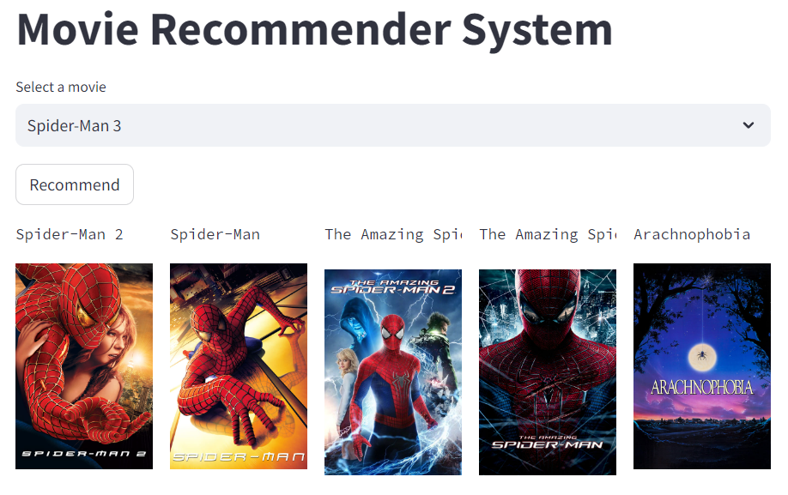
Introduction
The project focuses on integrating probability and statistics for enhanced accuracy and personalization.
The system aims to provide users with tailored movie suggestions, tackling challenges like data sparsity and dynamic user preferences.
A user-friendly interface for seamless interaction with the recommender system.

Slide 3
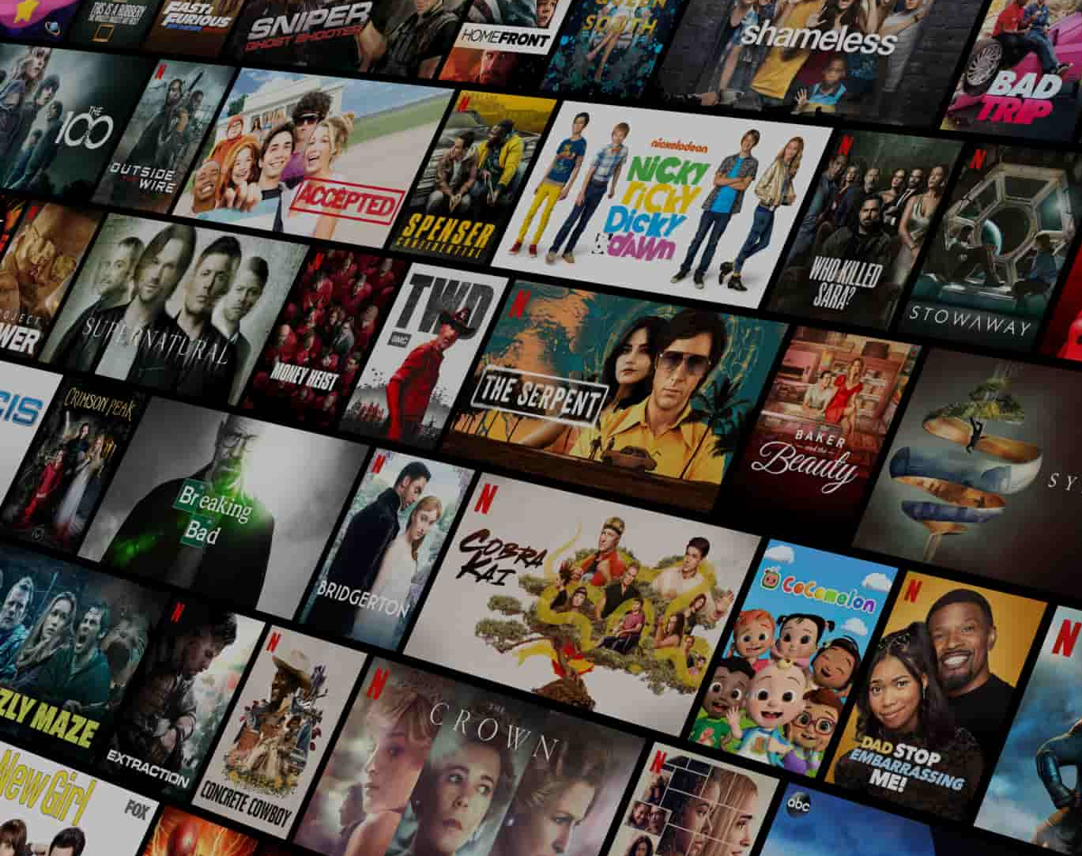
Problem statement
Traditional recommendation systems struggle to provide accurate suggestions in such scenarios
Users have diverse and evolving preferences, making it challenging to predict their movie choices accurately

Slide 4
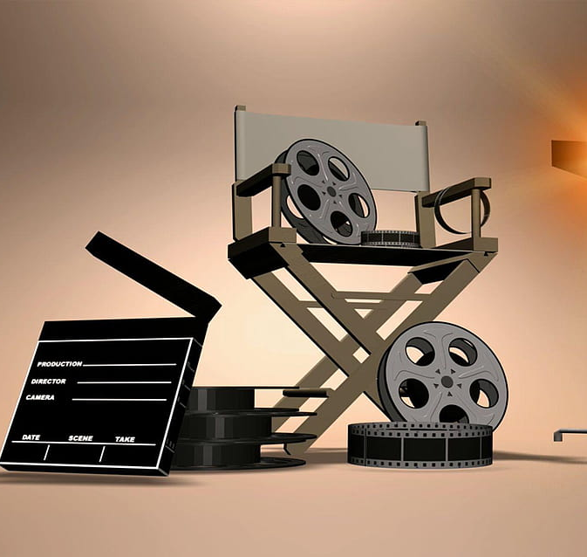
Solution
Content Based Filtering
User-friendly Interactive webpage
The system can offer accurate and personalized movie recommendations.

Slide 5

Technologies Used
Sklearn, pandas, NumPy, nltk
CountVectorizer
cosine_similarity
PorterStemmer
HTML, CSS, JavaScript

Slide 6
Project Blueprint
Selection of diverse movie dataset
Cleaning the dataset
Content-Based Filtering
Trimming the unwanted keywords
Making Vector set of each movie
Matching the vector set

Slide 7


